Slide 1


9. Natural Language Processing
Mrinal Vashisth
PhD Year 2, Computational Psychometrics, TSU, RF
M.Sc. Human Development: Genetics, Neuroscience and Psychology, TSU, RF
M.S. Applied Mathematics and Information Technology (Systems Biology and Bioinformatics), ITMO, RF
B.Tech. Biotechnology, JNU, RI

Slide 2
Problem statements
Theory building in psychology is a difficult task
Psychology relies on latent variables (psychological constructs/ traits)
To define these constructs, we need:
Theoretical understanding of the observable character (operationalization)
All interactions with other constructs (scope of interaction)
Ensure that the constructs are appropriate (validity and reliability)
Text analyses have made it easier to find psychometric patterns in the data. However, how can we extract the tokens that are relevant to our psychological construct?

Slide 3
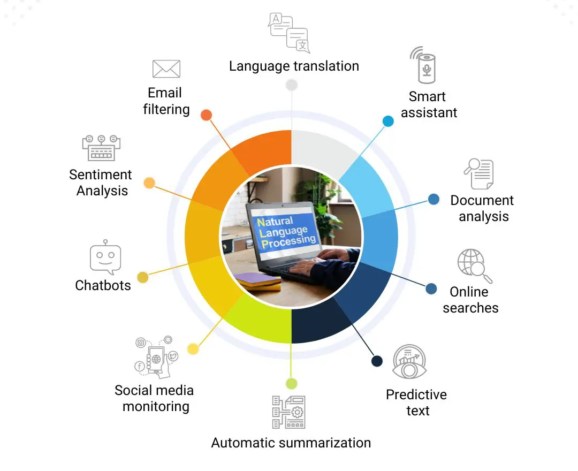
NLP?

Slide 4
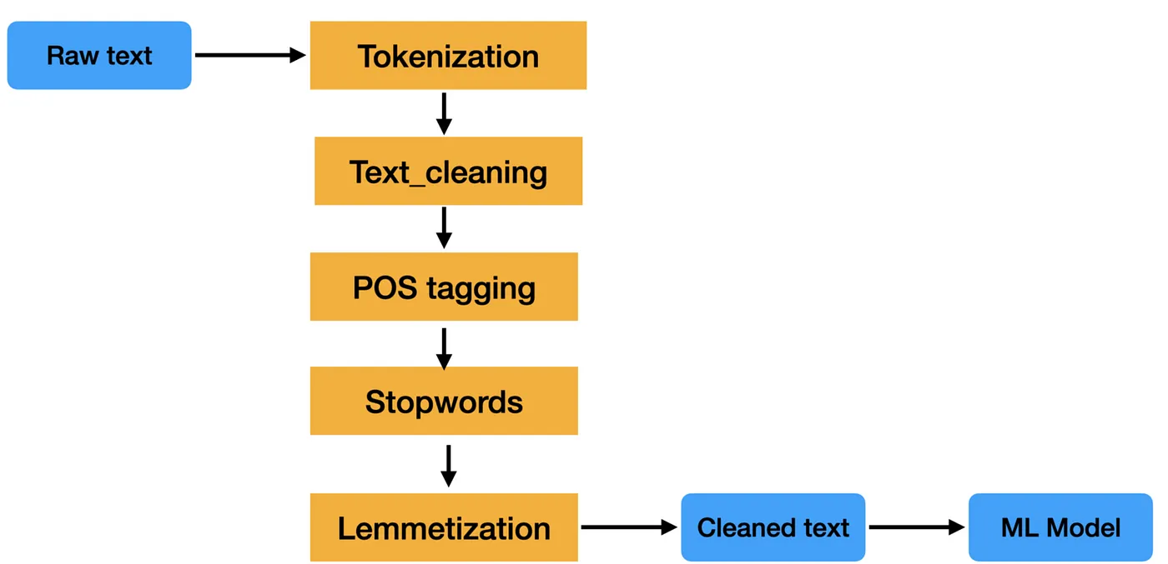
https://medium.com/mlearning-ai/basic-steps-in-natural-language-processing-pipeline-763cd299dd99
https://www.educative.io/blog/natural-language-processing-with-python-guide

Slide 5
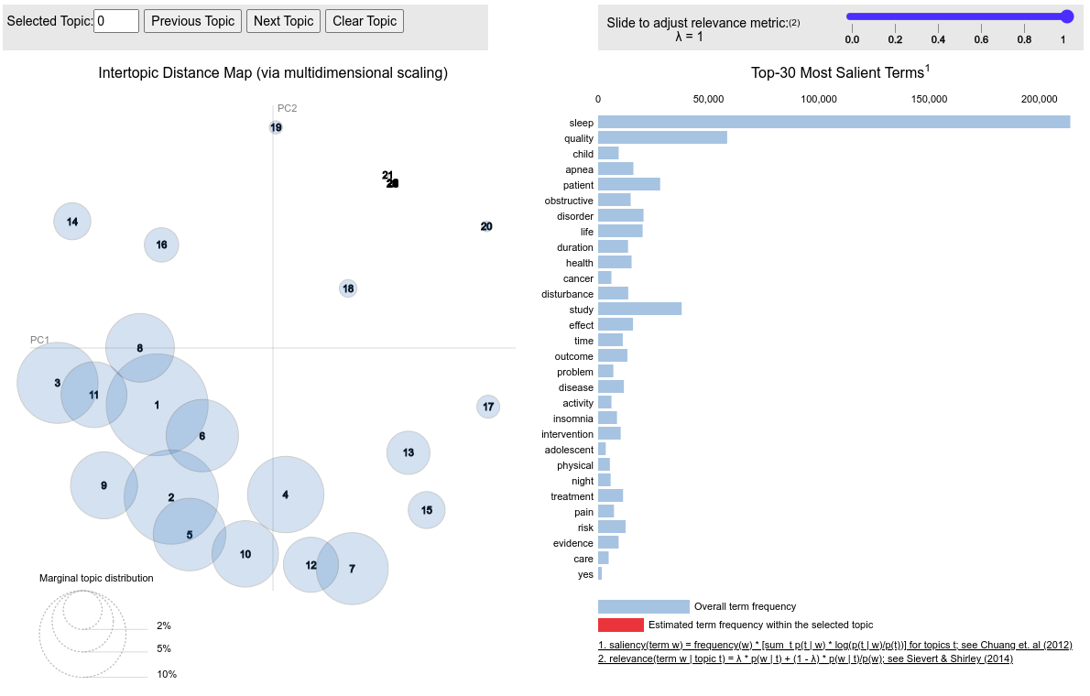
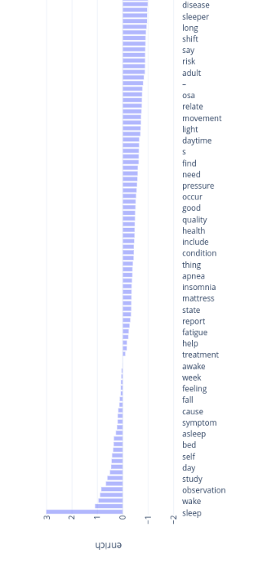
Input - Output
Document 1
word1, word2, word3, word4, ….. wordN
Document 2
word1, word2, word3, word4, ….. wordN
Summarization of text using modelling approaches, e.g. Latent Dirichlet Allocation
Identified construct based on a database
Document 3
word1, word2, word3, word4, ….. wordN
….
Document M
word1, word2, word3, word4, ….. wordN

Slide 6
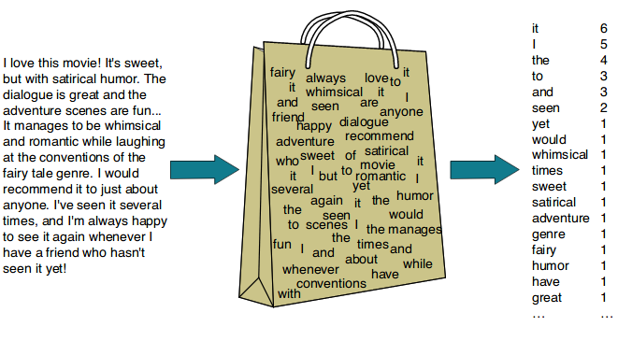
Bag of words
https://koushik1102.medium.com/nlp-bag-of-words-and-tf-idf-explained-fd1f49dce7c4

Slide 7
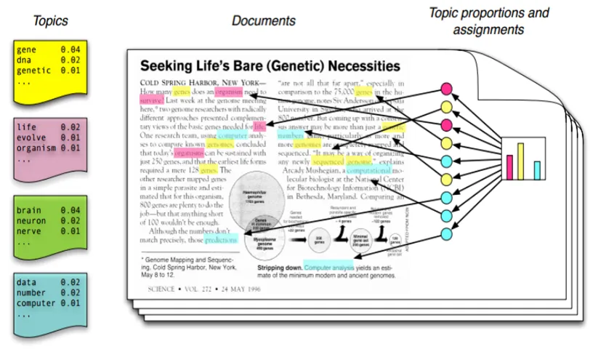
Latent Dirichlet Allocation
https://towardsdatascience.com/the-complete-guide-for-topics-extraction-in-python-a6aaa6cedbbc
I uploaded this as a pdf.

Slide 8
Go to Jupyter notebook 9

